Slide 1
Credit Markets in LDCs
Why are they underdeveloped?
What types exist and how do they work?
Are interventions justified? What kinds of intervention?
What role for institutions?
Partially based on Armendariz de Aghion and Morduch The Economics of Microfinance Ch.1, 2, 3

Slide 2
Some Puzzles about Financial Markets
Presumption that where capital is scarce, returns should be high and hence finance would flow to these markets from rich countries
Within LDCs the same phenomena should apply
Lucas (1990) Puzzle Why not?

Slide 3
Explanations
1.Local monopolies with high interest rates but often many lenders(Siamwalla et al (1993)
What happens when new providers enter? Do interest rates fall? Siamwalla found the answer to be No
2.Lender’s Risk Hypothesis: zero profit
p(1+i)L – (1+r)L =0 where p = probability of repayment, r = opportunity cost of loan
  Hence i= [(1+r)/p] -1

Slide 4
Other Features
  Credit rationing, larger loan raises default risk
  No Local loan to someone who might leave the community since future need for credit a major inducement to repay and repeat customers reduce the transaction costs of small loans
  Interlinked transactions also tend to reduce the information asymmetries. Landowners or merchants are lenders

Slide 5
3.Complementary inputs
Technology, Human Capital which are more plentiful in rich country or rich family may make mpk of rich person or rich country higher than in a poor one )
Hence profitable opportunities for lending in poor communities may be very limited

Slide 6
4. Financial Repression
Financial repression credit controls, controls on assets
  On banks
  On money lenders with ceilings on interest
This sometimes led to Subsidized State Banks
  Excess demand for credit at low rates
  Worsens income distribution since it goes primarily to rich farmers with collateral or to poor but unsustainable ones on social grounds
  Monopolizes credit market

Slide 7
How It Happens : Various Ways
Government or CB regulations are the cause of underdevelopment of financial markets
Fiscal deficits, Monetization of the deficits (given lack of development of bond markets), cause CB to increase reserve requirements forcing banks to hold the debt at artificially low interest rates
inflation, interest rate ceilings, sectoral allocations by CB or government
High NPL ratios (with banks government owned, or allocations by private banks to public sector firms)

Slide 8
Demonstration of the consequences of interest rate regulations on lending
r
r_{L}
r_{D}
D,L without
Financial repression
Deposits and Loans
D_{R},L_{R} with
financial repression

Slide 9
McKinnon-Shaw Reforms
De-regulate interest rates so as to avoid insufficiency of credit and let the market work better
IMF experience
IMF Conditions on loans
Open financial markets so as to attract funds and make banking system more competitive

Slide 10
5. Information and Transaction Costs
There are transactions across periods
Difficulties of assuring repayment across periods
  States of nature hard to predict
  Thus even well-intentioned borrowers may find it impossible to repay
  Willingness to repay hard to assess (information asymmetries)
  Dualistic markets: urban, rural differentials

Slide 11
Stiglitz and Information Approach
Asymmetries in Information
Banks themselves want to put ceilings on interest rates and loan ceilings
Adverse Selection
Higher the interest rate more likely those wanting credit will be high risk borrowers
Moral Hazard: Higher the interest rate, the lower the incentive to repay

Slide 12
The Role of Asymmetric information
Adverse Selection
Moral Hazard
Lenders insist on collateral and keeping loans small
  But collateral limited and very weak
    Weak property rights. (De Soto’s 2000 suggestion of formalizing informal rights to overcome this problem)
    Difficulty of assigning blame if something happens to the collateral
  Even when present, it is often more useful to a landowner-lender than to a bank
  Limited Liability (borrower cannot be forced to pay more than income). This is because as Steel (1997) showed for Africa, banks may have difficulty taking the assets of poor people. This will be assumed throughout subsequent analysis.

Slide 13
What kinds of reform suggested by Information Approach
Encourage more competition
Link formal and informal systems since the informal system has better information about borrowers
The informal system and solidarity groups for collective repayment
Developing credit rating agencies
Improving ability of lenders to get access to assets of defaulters (pros and cons)

Slide 14
Proposals to Marry Formal with informal Lending
Banks have lower cost access to funds but local moneylenders have better access to information about reliability of borrowers: Banks hire the moneylenders (Susu collectors in Ghana (Aryeetey and Steele (1995) who screen loan applicants on basis of their microsaving histories w/o being money lenders)
But how to trust the local moneylenders to be honest in their work for the banks?

Slide 15
Examples
Bose 1998
  New entrants to rural lending must lend to lower quality borrowers since existing local lenders already have relationships with higher quality ones. This raises the average default rate and raises risk premium in R
Floro and Ray 1997 for Philippines
  Moneylenders in a region collude to keep R high and collusion is strengthened by the threat of credit war. If the credit war were to occur, it would drive R down and undercut non-colluding lenders. But as probability of credit war rises, collusion strengthened

Slide 16
Other Examples
Fuentes (1996) If local agents are paid fixed wages, they may have little incentive to monitor. By compensating with a bonus based on loan repayment, this could help repayment.
When repayment is very sensitive to the size of the bonus, the bonus rate can be low. But when it is only slightly sensitive, the bonus would need to be high
But bank may not know this, Other things may also matter to the lender such as gender, ethnicity, the strong-arm tactics of the moneylender agents

Slide 17
More Examples Hoff and Stiglitz (1998)
1. Increased supply of lenders leaves each moneylender with smaller number of clients, MC rises and hence R
2. The extra supply of moneylenders lessens incentive of borrowers to repay. Hence competition may hurt.
3. With more lenders with less attachment to borrowers, borrower reputations cannot be established as easily, lenders must put more effort into monitoring and enforcement, causing R to rise
Hence the subsidized credit from an outside party like government or formal sector lenders is not passed on to the borrowers but is swallowed up in lower efficiency

Slide 18
Adverse selection
Assume that borrowers are of 2 types: Safe and Risky who each have same expected returns
  Safe borrowers (subscript s): lender chooses an interest rate R such that y_{s}> k where k is lender’s cost of capital and y is the return. So R_{s} =k if lending is perfectly competitive
  Risky borrower R_{r} = py_{r}> k
Problem when there are both types of borrowers and lender cannot distinguish between them. Lender knows only that there is q probability that borrower is safe and (1-q) that borrower is risky

Slide 19
Assume that expected returns for the two types are the same, differing only in risk and bank is competitive so breakeven is relevant
New breakeven R: [q+(1-q)p]R_{b} =k
Rewriting it for R_{b,} R_{b}= k/ [q+(1-q)p]
Hence R_{b}= k +A where
  A= [k (1-q)(1-p)]/[q+ (1-q)p]
  Problem is that R_{b} may be sufficiently high that safe borrowers will not want to borrow from this lender. Then all borrowers are risky and the lender may not be able to stay in business.
  Some Illustrations:

Slide 20
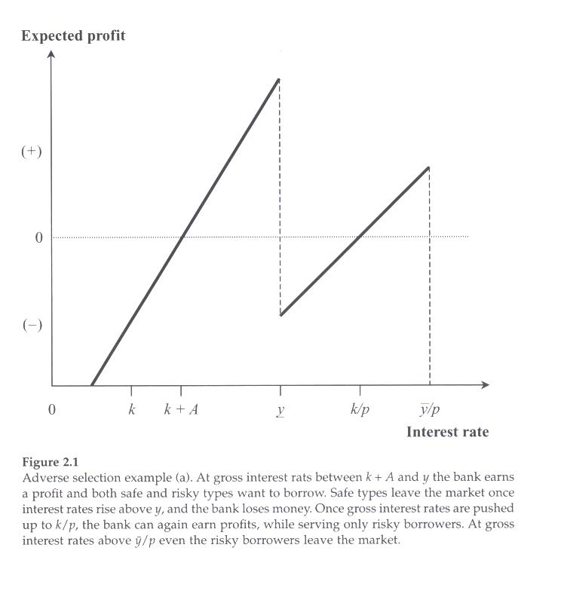
With both risky and safe borrowers

Slide 21
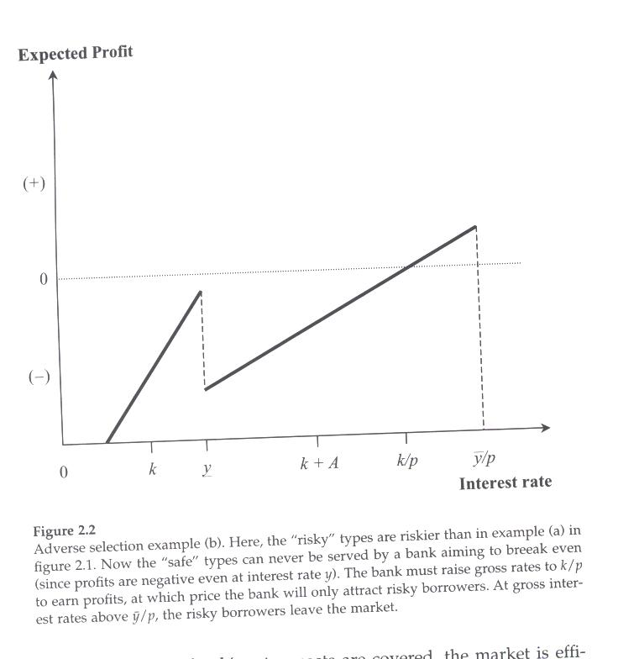
Risky borrowers are riskier

Slide 22
Types of Moral Hazard
Ex Ante Moral Hazard: That behavior after the loan is disbursed but before project outcome is realized that reduces expected repayment
  Effort to be made with a cost of c that makes y certain
  Types of crop to be planted. May go for riskier crop.
  Take the effort case:: Return = y-R-c (1)
  W/O effort Return = p(y-R) (2)
  Effort made only if (1)> (2) which implies that
  R<y-[c/(1-p)]. (3)
  Hence there is a limit on how high interest rates can be raised for effort to reduce risk to be made

Slide 23
Bank may be unwilling to lend
Assume situation where if borrower makes effort c, y-c> k. (1)
W/O ex ante moral hazard, borrower would commit to this and lender would lend and stay in business
But bank cannot force borrower to stick to this commitment. Even if (1) is satisfied, if k>y-[c/(1-p)]
so it sets R > [y-c/(1-p)], its breakeven R=k/p. Borrower will make no effort , the bank would then rationally choose not to lend at all. (This is where microfinance may be able to help as it might do so if borrower could commit to the efforts)

Slide 24
Suppose that there is collateral w <k
Incentive compatibility constraint of borrower is:
(y-R)-c>p(y-R) -w(1-p) implying that
R<y+w-c/(1-p) This allows R to be higher than in (3) so that bank might lend. But this would be true only if k<w but given aforementioned problems of collateral, this may be hard to achieve
Hence, collateral may help but poor rural people are unlikely to have it and banks unable to use it in practice.

Slide 25
Ex Post Moral Hazard
After the fact, even with good result the borrower can choose not to repay. The payoff of the project may be unobservable or payment unenforceable
Borrower may migrate

Slide 26
Ex Post Moral Hazard (with collateral)
The borrower may decide to default on the credit contract by running away or committing fraud in reporting profits, i.e., under-reporting them. Suppose this can be detected only with probability of s
Payoff if borrower repays: y+w-R
Payoff for not repaying: (1-s)(y+w) +sy which implies that the constraint will be satisfied if R<sw. This is harder to satisfy than R<w. (sw may be raised by property rights strengthening and improvement of judiciary or by peer monitoring and social norms of repayment)

Slide 27
Empirical Evidence from Cull, Demiguc-Kunt, and Morduch 2007
Study of 124 microfinance institutions
Explaining repayment delinquency rates D =f ( R) for different types of lenders
For traditional lenders: D rise with R ,i.e. safe types choose not to borrow when R rises above their threshold 40% seems to be threshold level
For group lenders, no such pattern

Slide 28
Karlin and Zinman 2009 Experiment
Work with South African Lender to try to distinguish between Adverse Selection and Moral Hazard . Direct mail solicitations
Offers to fomer clients some with high interest rates , some with low interest rates. Both rates lower than normal rates. But when they showed up some given rates lower that what they expected. Some also given dynamic incentive could borrow again at the special rate if they repaid promptly. The preset differences separted into riskier and less risky pools With reoayment burder held constant, differences in repayment rates attributed to borrower types

Slide 29
Karlin and Zinman (2)
For moral hazard compare the repayment rates among those responding to offers at the same rate but actual loans still lower. Random assignment
Evidence weak evidence for adverse selection and repayment burden effect
But robust evidence in favor of moral hazard Sharp increase in repayment when only the incentive to repay is changed

Slide 30
The Dramatic Rise of Micro Finance Institutions
Year Number Clients
1997 655 16.5 millions
2000 1477 38.2 “
2002 2334 67.8 “
2006 3113 113.0 “
2007 3352 154.8
What are the sources of success and failure?

Slide 31
Spread of Microcredit
Muhammad Yunas at Chittagong University in Bangladesh
Started lending to nearby village of Jobra . Experiments successful. Then tries other parts of Pakistan
Small Group lending principle w/o collateral but joint responsibility
Spread quickly in part because of international financial support for it
But many subsequent schemes depart from the group approach to dynamic incentives or other approaches

Slide 32
ROSCAS and Credit Cooperatives
Less formal: ROSCAS They are common throughout world. No funds need to be stored. Accounting minimal. Mostly local, decline in importance as YPC rises
  Groups which meet regularly, each member contributing equally in small amounts to the common pot. One member get the “pot”. This rotates until everyone has gotten the pot once.
  Variants on how the person who gets the pot is determined: Random, Auction, Predetermined order then repeated
More formal: Credit Cooperatives (these typically have constitutions).

Slide 33
Simple Model of ROSCA Besley Coate and Loury 1993
n individuals desiring durable good θ of cost B
Additive Utility v( c ) +θ where c = non-durable good
Each individual earns y for T periods
For an individual not joining a ROSCA
Max (T-t) (y+θ) +tc
  (t) Where t is the purchase date of the durable, T-t is time interval after durable is purchased. Optimal strategy is to hold c to subsistence level so as to get θ asap.
c>= cbar (subsistence)
  t(y-c) >=B For a non-member (autonomous person)
  U_{A} = [T-B/(y-cbar](y+θ) +[B/(y-cbar)] cbar (1)

Slide 34
If person joins ROSCA
Assume would get pot in ith period with prob. 1/n
Lifetime utility :
Ui = (i/n)tc +[t-(i/n)t](c-θ) +(T-t)(y+θ)
    ind. U before pot + u after getting pot but before repayment + u once everyone has received pot
    If doesn’t know when he will get pot
    U_{R} =1/nΣ_{i}^{n}u_{i} where R is an individual who does not know when she will receive pot
U_{R} = (n+1)/2n)tc +[(1-(n+1)/2n]t](c+θ) +(T-t)(y+θ)
    t is time required for t(y-c) =B Substituting for t
U_{R} = (Bc/(y-c) +[(1-(n+1)/2n]Bθ/(y-c) +[(T-B/(y-c)] (y+θ) (2)
    Since (2)>(1) ROSCA gives each member possibility of getting durable good sooner.

Slide 35
What is primary motive of a group?
Early pot motive (Besley, Coate and Loury 1993,1994)
Risk-sharing motive, especially in bidding for ROSCAs
Hh conflict motive (Anderson and Baland 2002)
Commitment to saving motive (time inconsistent preference: impatient currently but patient in future (hyperbolic preferences) (Rutherford 1997, Gugerty 2003) But this could alternatively reflect absence of a way to save (May explain why last in line in pre-set order still participate)
Richer people interested in bigger pots and less frequent ROSCA meetings than poor.

Slide 36
Ashraf, Karlin and Yin
For Philippines develop measures of preferences of rewards of different sizes now and in future and show that individuals with hyperbolic preferences are more likely to join ROSCAs
Males and females may have different preferences

Slide 37
Problem of Sustaining ROSCA
Once individual gets the pot, she does not have incentive to keep contributing .
Impose sanctions on those who abscond (e.g., by threatening to exclude them ever again if they do but Anderson, Baland and Moene show this not to be sufficient). May also ban those members who are unreliable from alternative sources of credit.
But lack of alternative ways of saving can be another incentive for continuing participation
The use of selection by lottery, keeps those not selected early in the process
Hence group needs to be dependable and people with whom people interact frequently. Screening of members taken seriously.
Less important for wealthier hhs who either do not need credit to buy durables or who can get bank credit with collateral
Need to be able to save at least a small amount on regular basis
Amounts, frequency of meeting and membership tend to be inflexible over I ROSCA cycle

Slide 38
Gender: Anderson and Baland 2002
Males and females may differ in their preferences for saving (females greater)
Hence hh saving may depend on relative bargaining power (Thomas 1990, 1993).
Predict an inverted-U relationship for participation
Measured wife’s bargaining power by her share in hh income. But this could be endogenous to ROSCA choice and also reverse causality.
Matsumoto 2005 does this for other instruments such as her share of assets, past assets, educational differences and still finds the same pattern. His results are as follows:

Slide 39
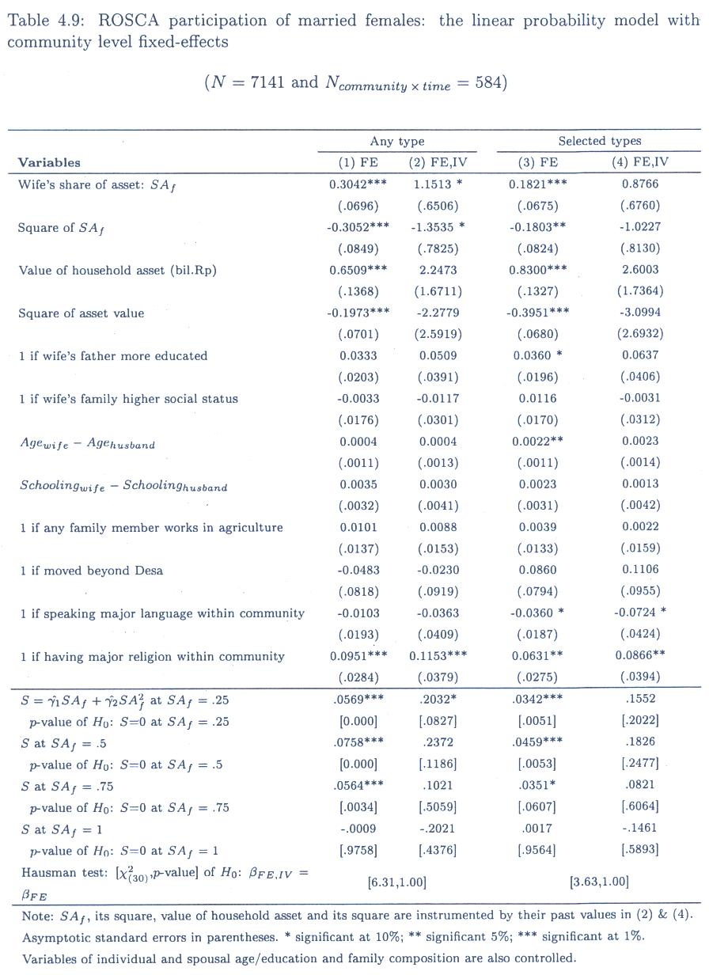

Slide 40
Mel, McKenzie and Woodruff 2008
What happens to returns to SriLankan mico-enterprises when a random sample receives cash inputs to help them ?
Shows that risk aversion may not play much of role on returns to capital

Slide 41
Klonner and Rai: 2008 on ROSCAS
Showed that pool of borrowers got riskier when Supreme Court of India put a ceiling on Rate that for funds

Slide 42
Evidence on Motives and effects
Besley and Levenson: ROSCA participants in Taiwan more likely than non-members to buy durables after controlling for income and endogeneity of participation
Anderson and Baland (2002) similar for Nairobi say thast women favor ROSCAS because of desire to avoid wasteful spending (by husbands)
Gugerty (2007) for Kenya Asked ROSCAS members and found that commitment to savings was most important
Rutherford (1997) for Bangladesh and Collins for South Africa obtain similar findings

Slide 43
Limitations of ROSCAS
1. Hard to change the rules , at least within the cycle, though bidding ROSCA may help. Allocate according to who is willing to pay most for it. But this may be risker borrowers increasing risk of default
2. Cannot mobilize funds from outside the group

Slide 44
Credit Cooperatives or Credit Unions
Where some do mostly saving and others mostly borrowing.
Savers no longer forced to borrow and loans can vary in size according to needs of borrowers Friedrich Raiffeissen: in Germany and subsequently internationally.
Mostly for 10 years and for agricultural machinery
Make use of social sanctions within the community Members were all members of same church, unlimited liability of defaulters ,equal rights to the poor
Could extend both short term and long term loans
Peer monitoring may be useful to avoid misallocations of resources
Adams (1995) for Latin America said that they are generally fragile, with thin capital bases

Slide 45
How does peer monitoring work?
Banerjee, Besley and Guinnane 1994
Cooperative with 2 members One has project but it is risky. It yields y with prob of p and 0 with prob (1-p).
If members are poor , they have to obtain funds from outside bR <y when project succeeds but when it fails the borrower is protected by limited liability. But with credit coop, 2nd member may be willing to lend the amount of investment needed above which the outside lender may provide or to offer collateral. May also induce through monitoring the borrower to make more effort to pay back

Slide 46
Example
Assume additional effort of borrower will raise p of success one to one and monitoring can also stimulate effort.
Cost of effort: .5 (1/m)p²
Where m represents monitoring intensity, suggesting that cost of effort declines with monitoring
Sequence (1) Borrower contract loans with inside and outside lender
  (2) Inside lender chooses how much to monitor
  (3) Borrower chooses effort p
  (4) Project outcome is realized

Slide 47
Example (Continued)
For given m by insider, borrower chooses p to maximize: p(y-Rb)-.5(1/m) p²
Solution p= m(y-Rb)
But why should insider monitor?
Insider might have wealth of w which would be offered as collateral when R is not repaid. But this would relieve outside lender of risk so the cost of the loan may be simply the opportunity cost r<R which in turn would raise effort since p is now :
m(y-rb) and insider could bargain for a share of this residual return (y-rb)

